Slide 1
The Air Training Corps History of the ATC

Slide 2
Lesson Objectives:
By the end of this lesson we will;
Be able to say how the ATC was created.
Be able to describe the aims of the ATC.
Be able to say some of the opportunities available.

Slide 3
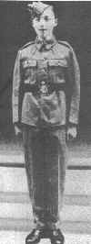
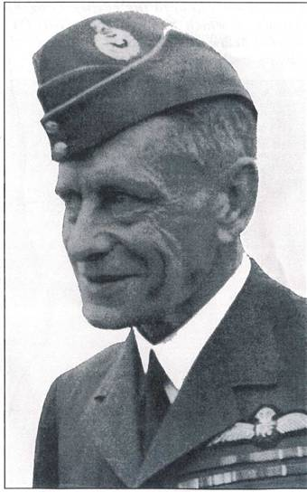
Origins of the Air Training Corps
In 1938 the Air Defence Cadet Corps
(ADCC) was formed by a retired RAF
Officer:
Air Commodore JA Chamier
The aim of the ADCC was to provide
training to young men interested in Aviation, and prepare them for service in the RAF or Fleet Air Arm.
When war broke out in 1939 ADCC Cadets
provided valuable assistance to the RAF

Slide 4
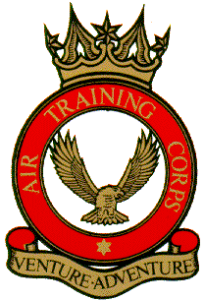
Formation of the Air Training Corps
The RAF was so impressed by the
Contribution of the ADCC that it
took over and created the
Air Training Corps (ATC).
Air Commodore JA Chamier was
appointed as Commandant.
Known as the “Father of the ATC”
King George VI became Air Commodore
In Chief and issued a Royal Warrant on
5th February 1941.

Slide 5
Aims of the ATC
The Royal Warrant sets out the Corps aims as:
a. To promote and encourage among young people a practical interest in aviation and the Royal Air Force.
b. To provide training which will be useful both in the Services and in civilian life.
c. To foster the spirit of adventure, and to develop the qualities of leadership and good citizenship.

Slide 6
The ATC moto ‘Venture Adventure.

Slide 7
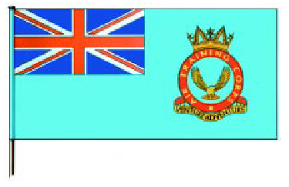
Development of the ATC
The first 50 Squadrons are known as “Founder” Squadrons,
and have an F after their Squadron number.
ATC became part of Royal Air Force Reserve Command
When the Second World War ended in 1945
When King George VI died, HRH Duke of Edinburgh Prince Phillip became Air Commodore in Chief in 1953
Prince Phillip handed over his appointment as Air Cmdr in Chief in 2015 to the Duchess of Cambridge, Catherine Middleton
The ATC Ensign

Slide 8
Girls joined
1980 girls were allowed to join the ATC
By march 1999- 8682 Female cadets were enrolled.

Slide 9
The ATC 2010
There are over 43,000 cadets, in almost 900 Squadrons and Detached Flights, all over the country.
Compare this to the 40,000 RAF personnel.

Slide 10
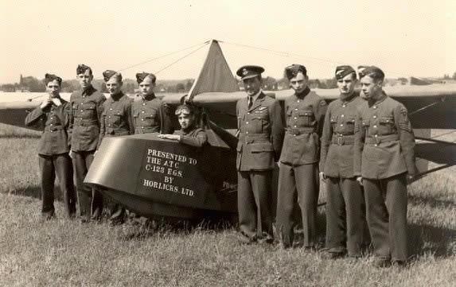
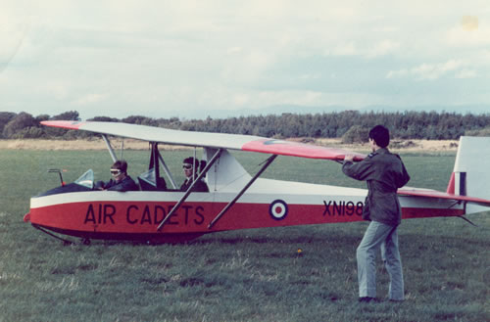
Gliding
Gliding training was first introduced
during the war years, using single
seat gliders.
In 1950 2 seat gliders were
introduced.
T21B Sedburgh
Kirby Cadet Mk3

Slide 11
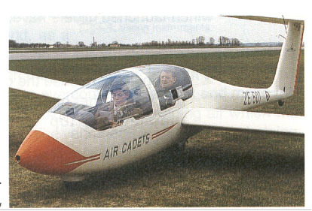
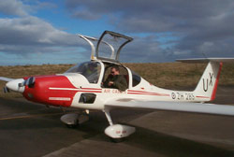
Gliding Opportunities
The Air Cadet Gliding fleet was
updated in the 1980s
Opportunities
Familiarisation (AEG)
Initial Gliding Training (IGT)
Basic Gliding Training (BGT)
Advanced Gliding Training (AGT)
Gliding Instructor
Viking
Vigilant

Slide 12
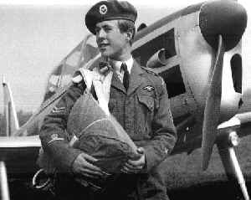
Air Experience Flying
In 1957 Air Experience Flights were set up
to provide Cadets with flying experience and training

Slide 13
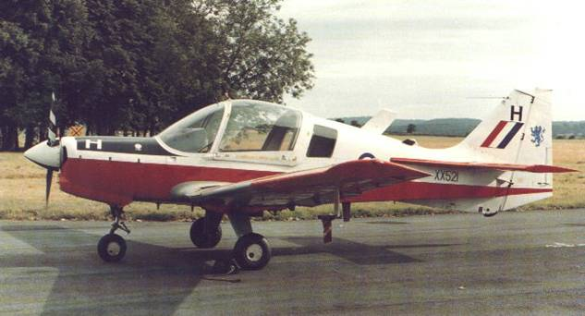
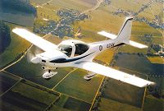
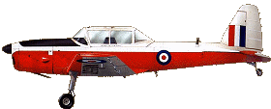
Air Experience Flying
Chipmunk
1957-1996
Bulldog
1996-1999
Tutor
1999-present
Flying Opportunities
AEF
Flying Scholarship
Pilot Navigation Scheme
Microlight Training

Slide 14
D of E Award- (DEA)
In 1956 the ATC was asked to trial the new
Duke of Edinburgh Award Scheme.
Cadets can take part in the DofE Award
Scheme at all three levels

Slide 15
Evaluation
Who created the ATC?
What was he known as?
Outline the three aims of the ATC.
Who is the current Air Commodore in Chief of the ATC?
What year were females allowed to join the ATC?

Slide 16
The ATC Organisation

Slide 17
Learning Objectives:
By the end of this lesson we will:
Know the structure of the ATC.
Understand how each part works.
Be able to distinguish between different adult ranks.

Slide 18
Family Tree
Air Force Board
Air Cadet Chaplains Committee
Air Cadet Council
Commandant RAFC Cranwell
Corp Chaplain
HQ Air Cadets
Regional Chaplain
Regions
Regional Council
Wing Chaplain
Wings
Wing Committee
Squadron Chaplain
Squadrons
Squadron Committee
Detached Flights

Slide 19
Detached Flights
Around 15 Cadets
Reports to a local Squadron
Staff are volunteers
Normally commanded by a Flying Officer
Detached Flights

Slide 20
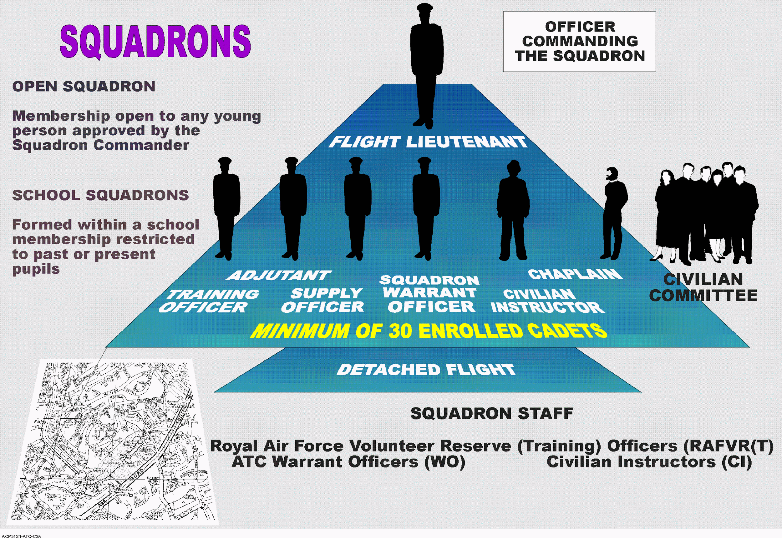

Slide 23
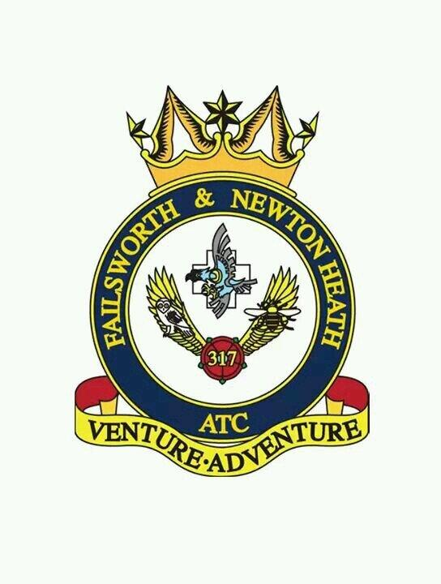
Squadrons
The basic unit of the ATC
Minimum of 30 Cadets
Staff are volunteers
Normally Commanded by a Flight Lieutenant
Has a Civilian Committee and a Padre
Squadrons
Detached Flights

Slide 24
Squadrons
Commanding Officer
Squadron Adjutant
Training Officer
Squadron Warrant Officer
Supply Officer
Instructional Staff
Cadet NCOs
A Flight
B Flight
C Flight (Recruits)

Slide 25
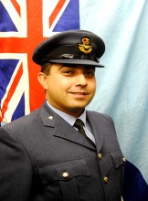
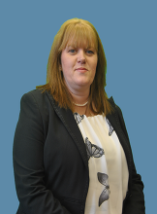
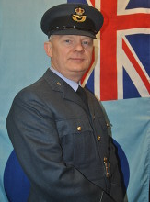
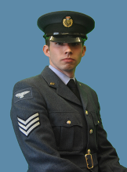
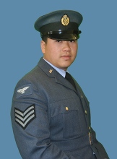
317 Staff Tree

Slide 26
317 NCO Tree

Slide 27
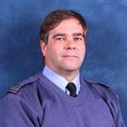
Wings
Full-time of 3
Volunteer staff
Commanded by a volunteer Wing Commander
Has a Civilian Committee and a Padre
We are part of Greater Manchester, which contains 36 Squadrons and a Detached Flight.
Currently our Wing Commander is Wg Cdr David Archibald.
Wings
Squadrons
Detached Flights

Slide 28
Wings
Wing Commander
Specialisations ( 1 Sqn Ldr + 1 Flt Lt)
Area Staff Officers
(4 X Sqn Ldr’s)
Headquarters Staff
Duke of Edinburgh’s
Public Relations
Ground Training
Adventure Training
Sports
28 Squadrons & Detached Flights
Wing Administrative Officer (Sqn Ldr)
Administration Officer
Admin Assistant

Slide 29
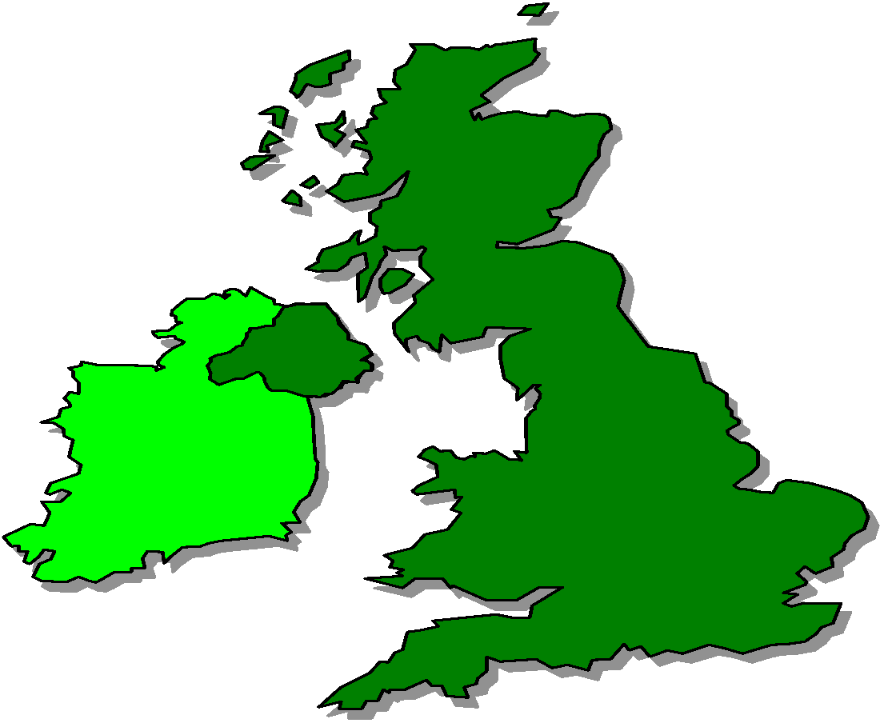
ATC Regions
SCOTLAND &
N IRELAND
317 ATC
Squadron
RAF Cranwell
HQ Air Cadets
NORTH
WALES
&
WEST
CENTRAL & EAST
(RAF BRAMPTON)
LONDON
& SOUTH EAST
SOUTH WEST

Slide 30
Regions
Full-time of 4
Volunteer staff officers
Commanded by a full time Group Captain
Has a Civilian Committee and a Padre
We are a part of North Region Air Cadets.
Currently our Regional Commandnt is Group Captain Mark Leeming.
Regions
Wings
Squadrons
Detached Flights

Slide 31
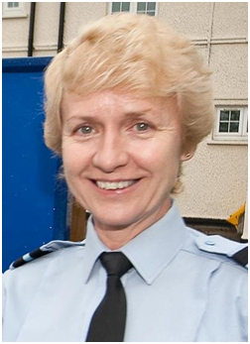
Headquarters Air Cadets
HQ Air Cadets
Based at RAF College Cranwell
Large full-time staff
Commanded by a Air Commodore
Currently the OC Air Cadets is Air Commodore Dawn Mccaferty.
Regions
Wings
Squadrons
Detached Flights

Slide 32
Air Commodore in Chief
HRH Duke of Edinburgh Prince Phillip
Mainly Ceremonial role
HQ Air Cadets
Regions
Wings
Squadrons
Detached Flights

Slide 33
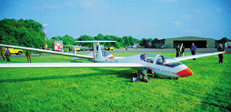
Volunteer Gliding Schools
Provide Gliding experience
27 Schools
Grob Vigilant + Grob Viking gliders
Volunteer Staff
Commanded by a Squadron Leader
Report to HQ Air Cadets
HQ Air Cadets
Volunteer Gliding Schools

Slide 34
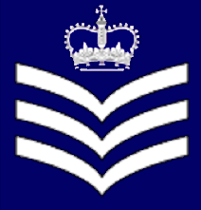
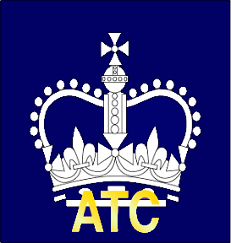
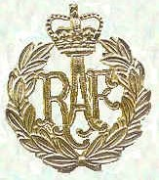
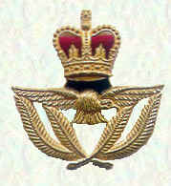
NON COMMISSIONED RANKS
ATC
ATC
Sargent (ATC)
Flight
Sargent (ATC)
Warrant
Officer (ATC)

Slide 35
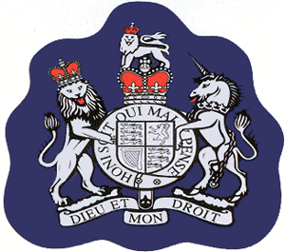
Warrant Officer (ex Regular WO or appointed before 1980)
Sleeve Badge
Cap Badge

Slide 36
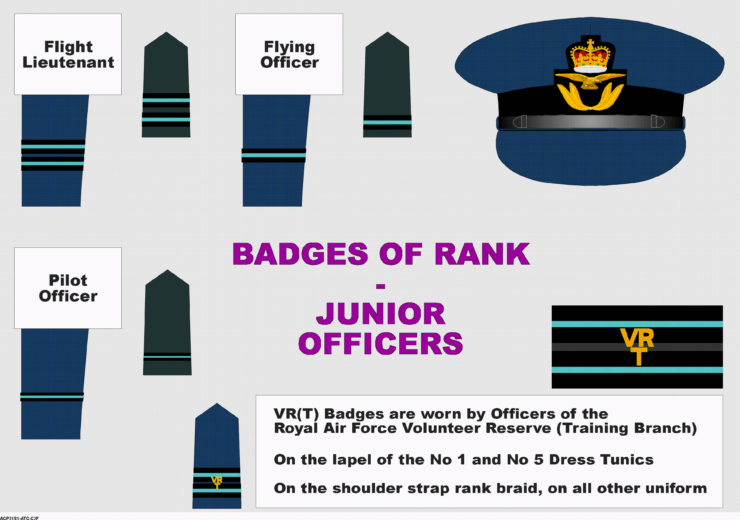

Slide 37
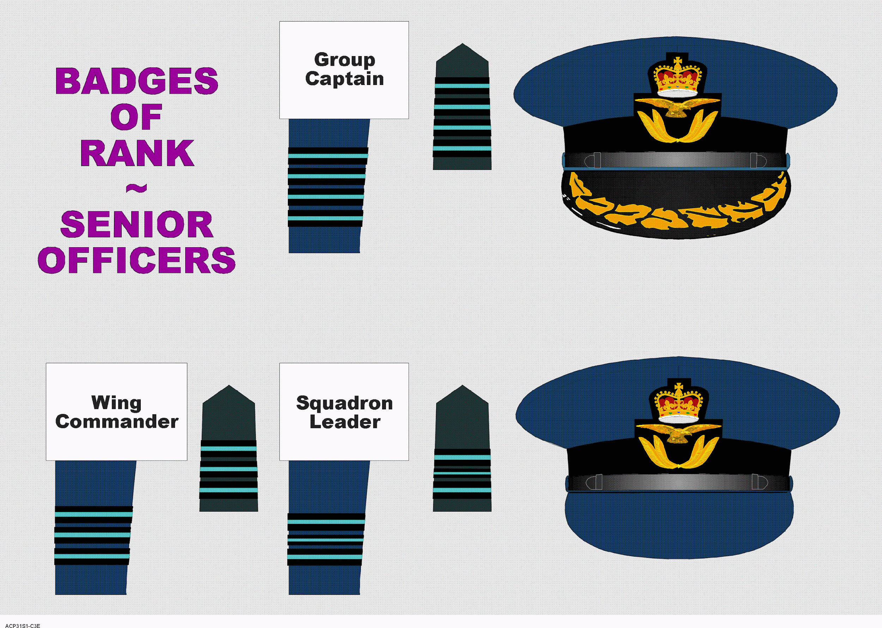

Slide 38
Station Commander’s Car Flag
Salute ALL cars with flags or star plates on!

Slide 39
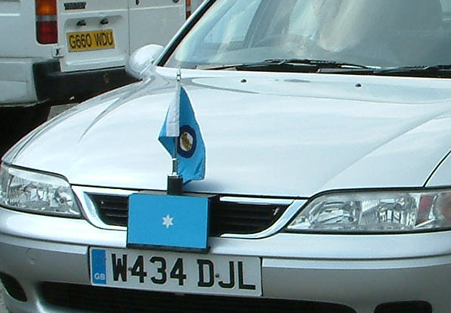
“One Star” plate and flag

Slide 40
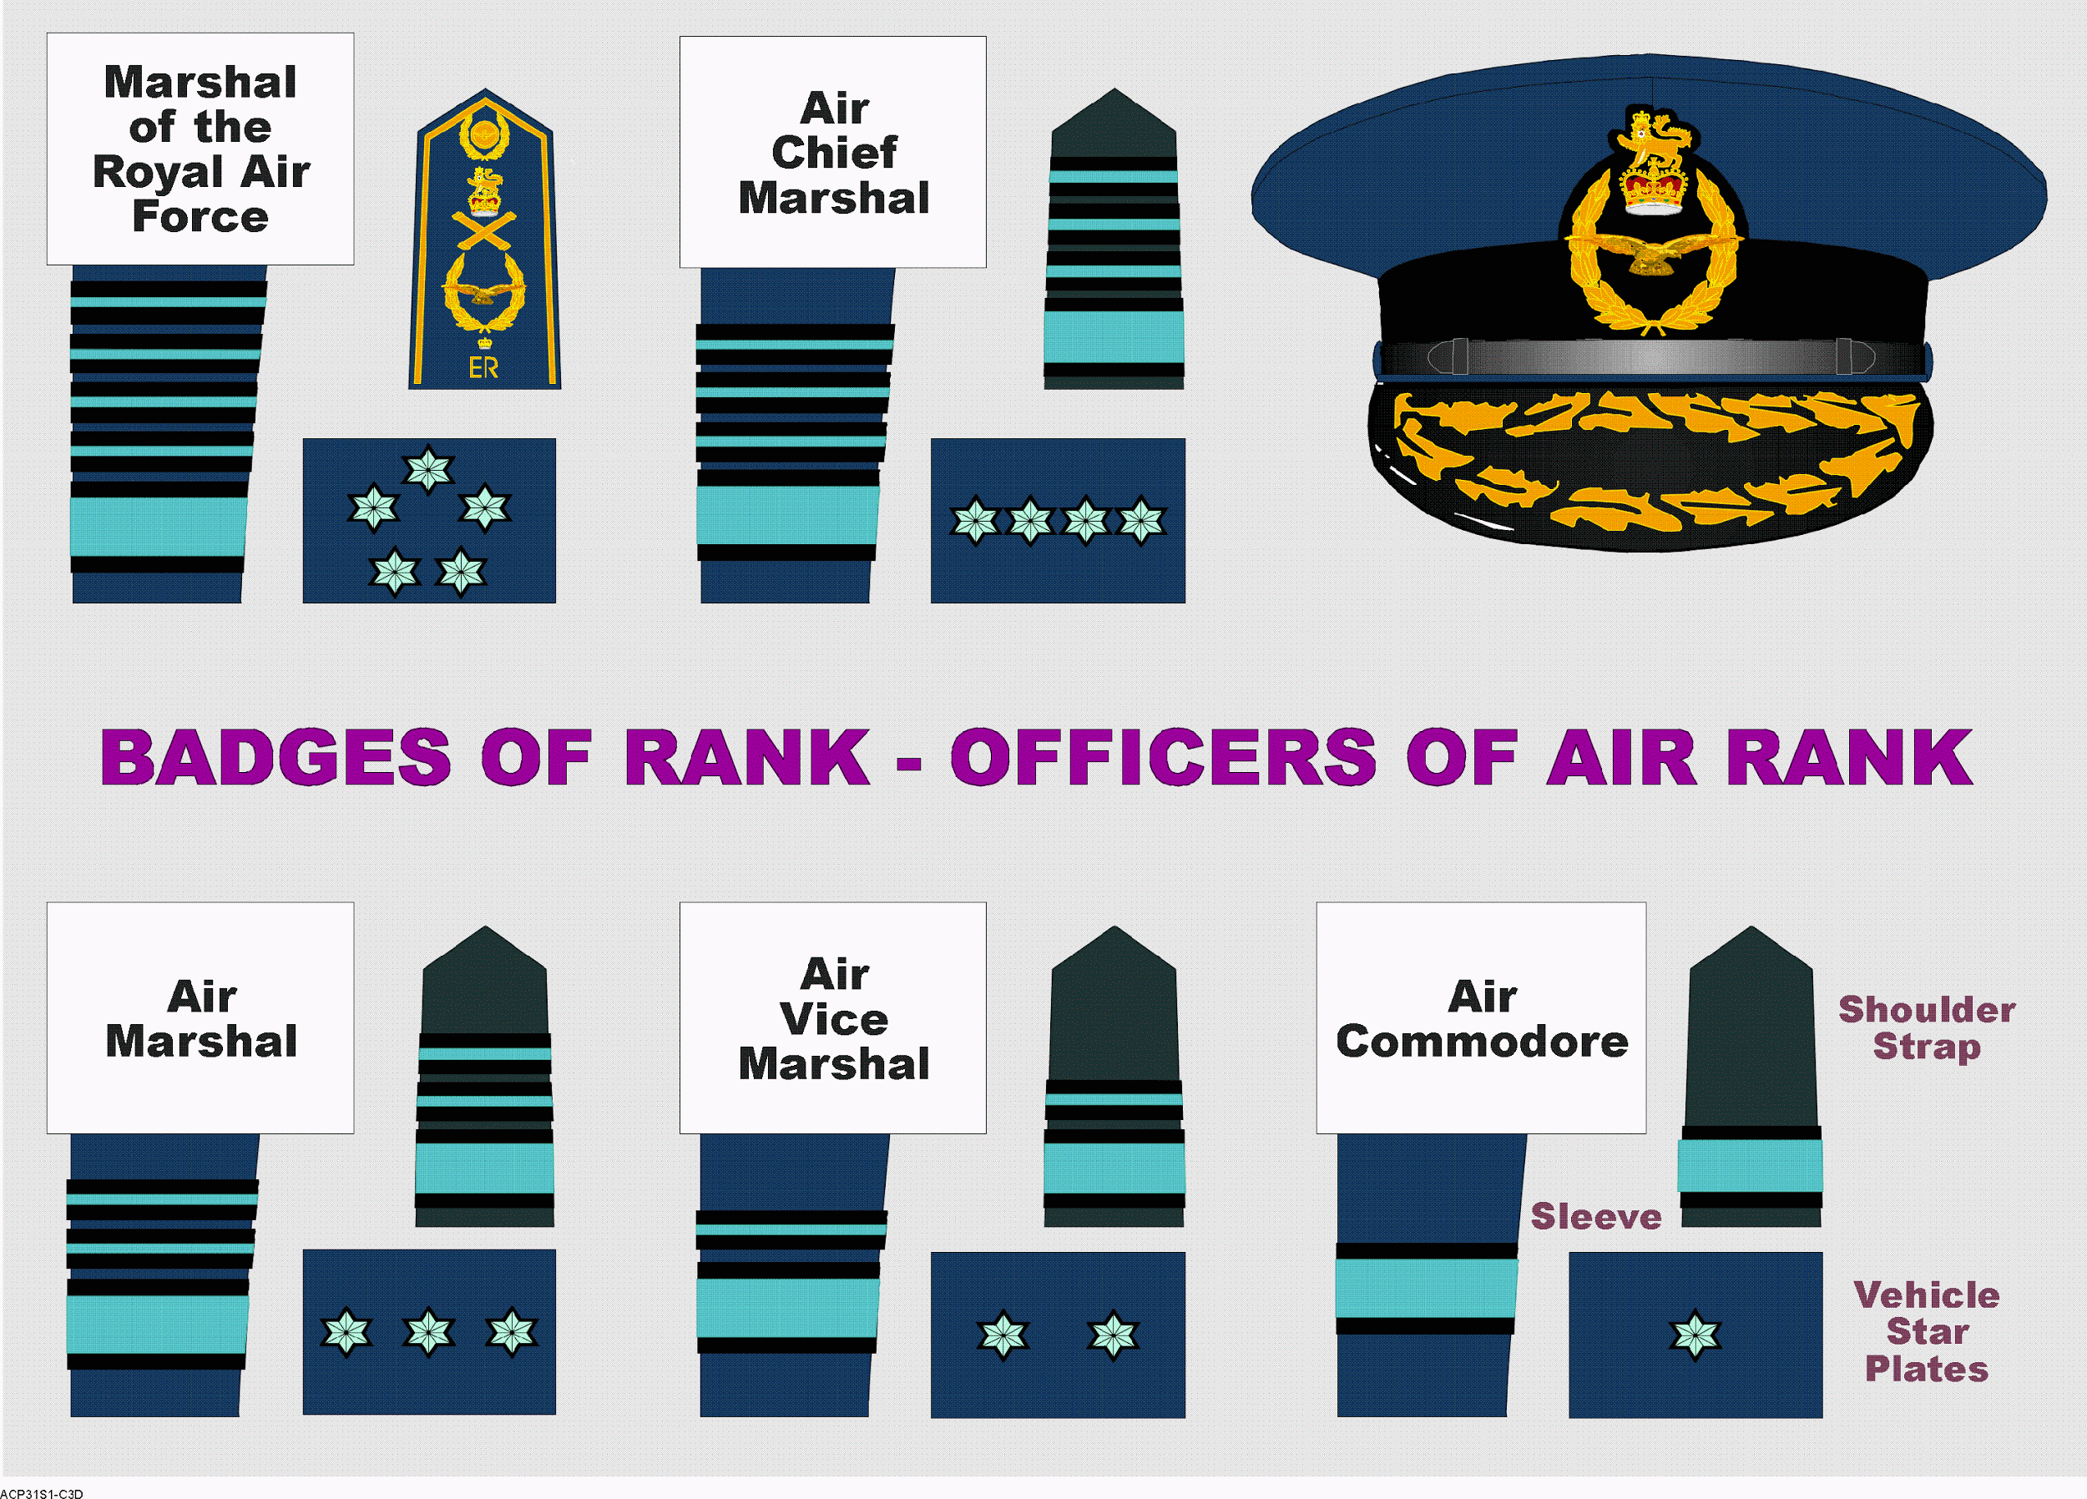

Slide 41
Evaluation:
What rank is usually held by the OC of a Squadron?
Who is the OC of Greater Manchester Wing?
Who is the OC of the Air Cadets?
Name these 4 ranks.

Slide 42
CADETS
Uncontrolled Copy Not Subject To Amendment

Slide 43
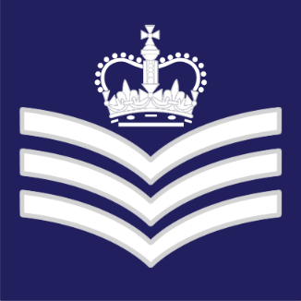
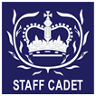
Cadets
Cadets can also attain rank within the ACO, and become a Non-Commissioned Officer (NCO).
The NCO rank structure is the same as that of the RAF.

Slide 44
Cadets
The first rank you may earn is Corporal (Cpl).
With this rank you are part of the Junior NCO team.
You will wear this:

Slide 45
Cadets
The next rank you may earn is Sergeant (Sgt).
With this rank you are part of the Senior NCO team.
You will wear this:

Slide 46
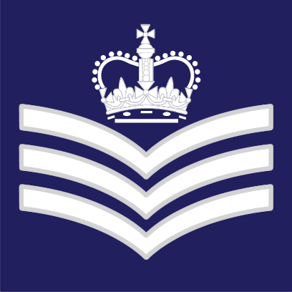
Cadets
The final rank you can earn from your Squadron Commanding Officer is Flight Sergeant (Flt Sgt).
You will wear this:

Slide 47
Cadets
After you have attained the rank of Flt Sgt, your CO can give a recommendation to the Wing Commander for your promotion to Cadet Warrant Officer (CWO).
You can only achieve the rank of CWO when you are 18 years old and have passed the various selection processes and interview boards.
You will wear this:

Slide 48
The Classification System
The classification system is completely different from the rank structure.
Classifications indicate the level of training you have attained.

Slide 49
Cadet Classification
Classification
Junior Cadet
2nd Class
Cadet
1st Class Cadet
Leading Cadet
Senior Cadet
Master Air Cadet
Instructor Cadet
IDENTIFY
None
None
Role
Under Trg
Under Trg
Under Trg
Under Trg
Under Trg
Under Trg
Some Assistance on Sqn
Trg Subject/s
-
2
6
3
3
3
One-day Methods of Instruction with assessment
The classification system works on a 6 month training program for each classification.

